Slide 1
Decision Making in the Face of Deeply Uncertain Threshold Responses
Jan Kwakkel, Caitlin Spence, and Klaus Keller

Slide 2
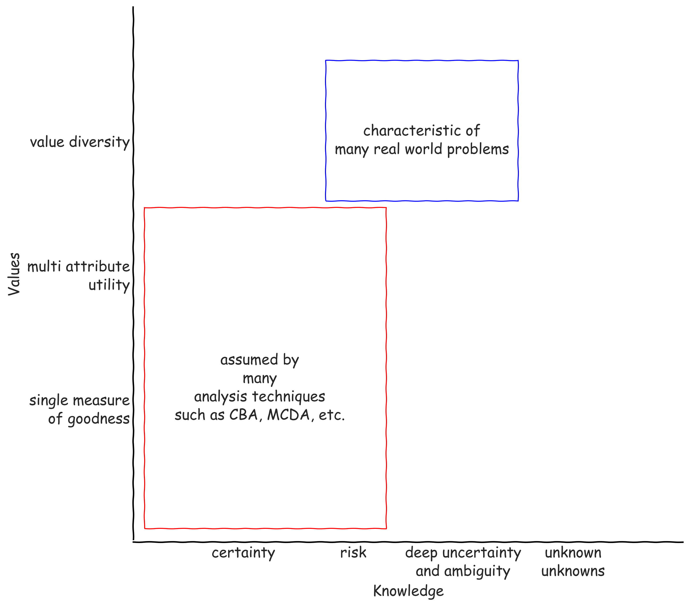

Slide 3
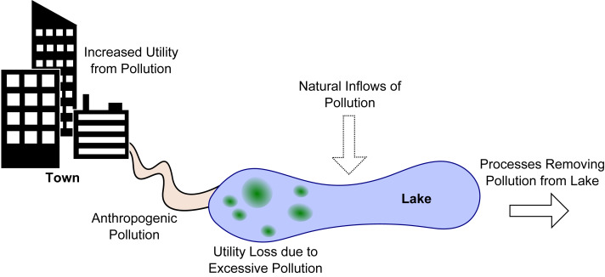
Lake Problem
Adapted from Hadka et al (2015) doi: 10.1016/j.envsoft.2015.07.014

Slide 4


Slide 5
Endogenous learning

Slide 6
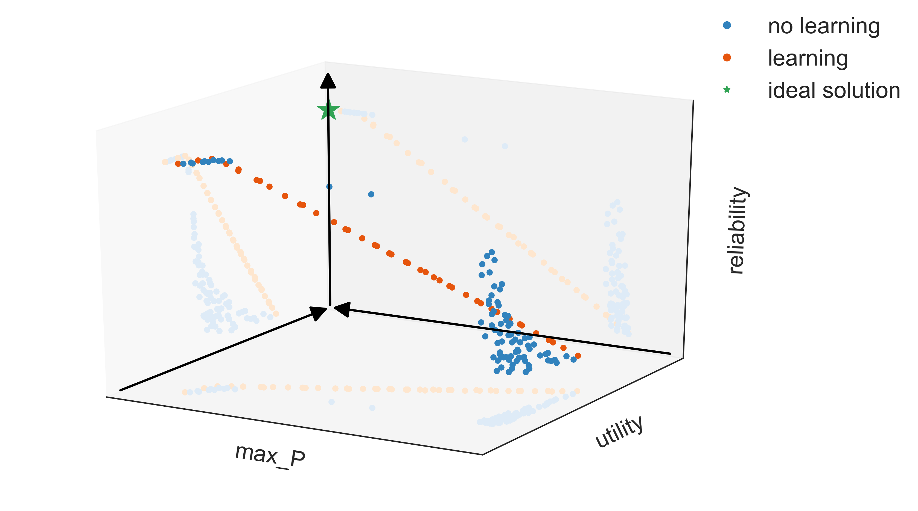

Slide 7
Deep Uncertainty
Do we know the correct parameterization for the natural inflow?
Do we know this exactly?
How to discount this over time?

Slide 8
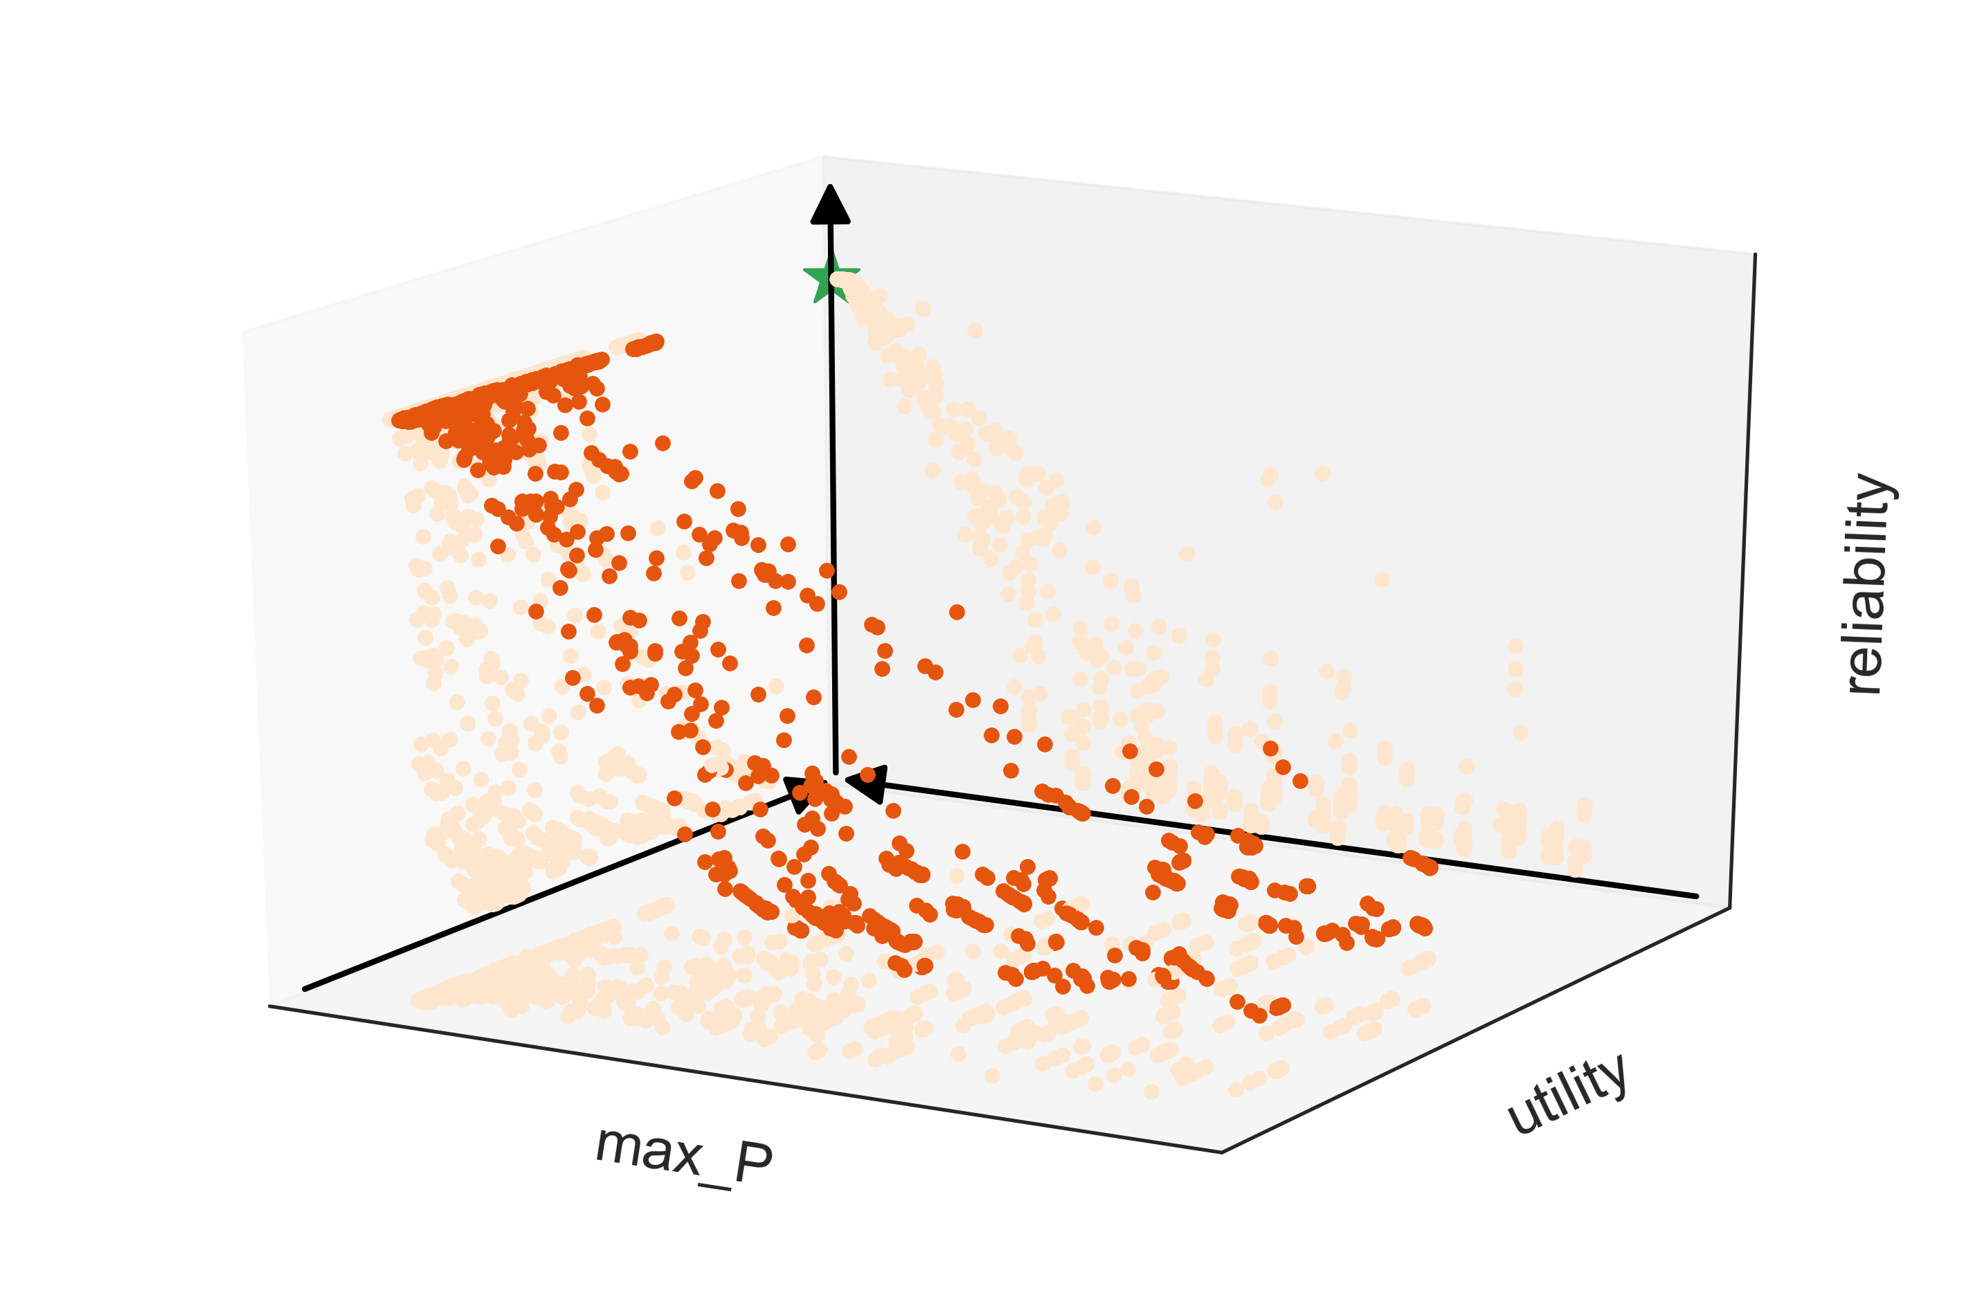
Deep Uncertainty re-evaluation
Notes:
Performance of learning solutions with a reliability > 0.6 in the reference case over 1000 samples across the various deep uncertainties

Slide 9
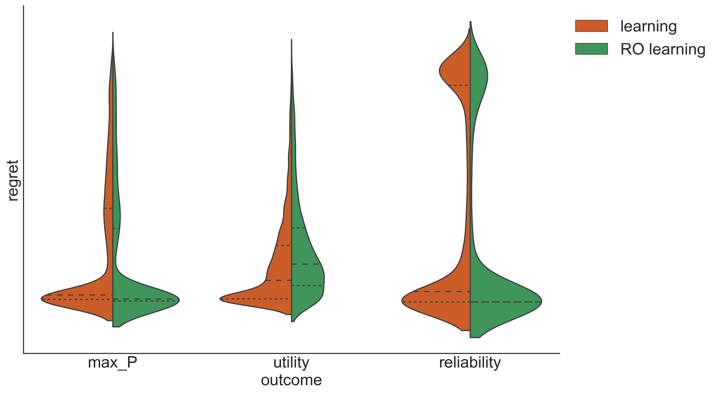
Robust search versus reference scenario search

Slide 10
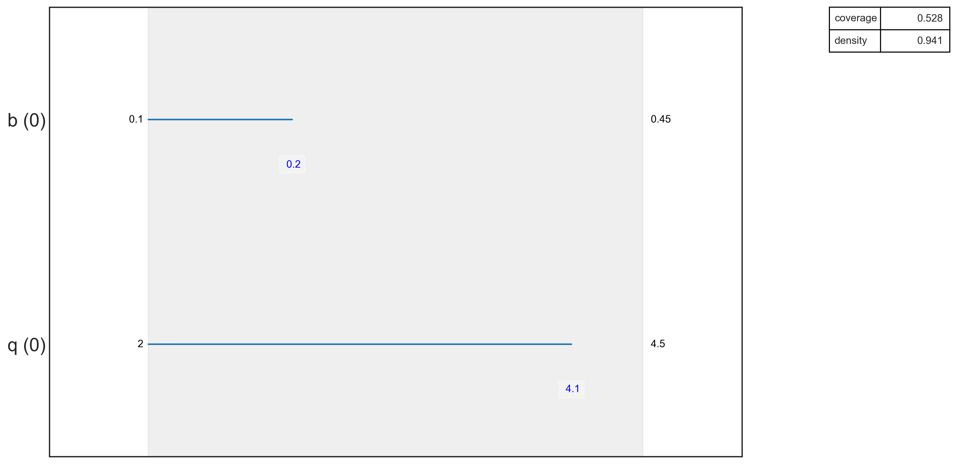
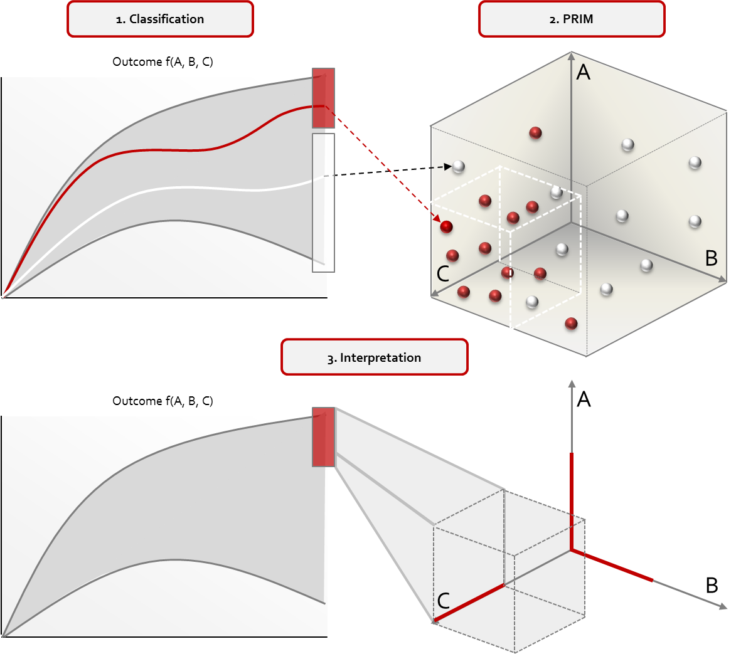
Scenario Discovery

Slide 11
